Slide 1
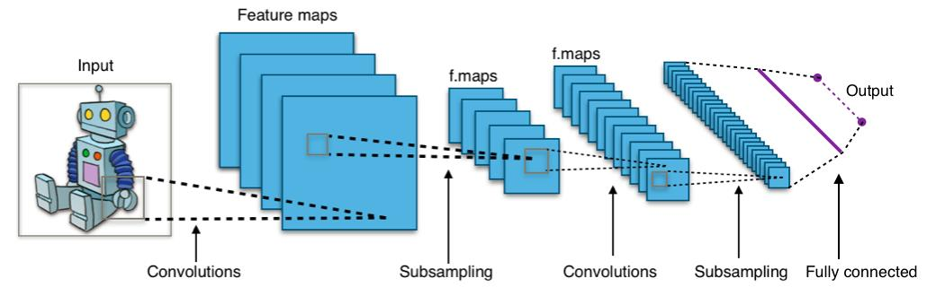
Handwritten Digit Recognition
Using Convolutional Neural Network
Presented By-: Sanskar Agarwal
BTECH/10231/18

Slide 2

Contents
Objective
Application
Introduction to CNN
Working
Algorithm
My Experience

Slide 3

Objective
Notes:
Consider talking about:
Convolutional
Pooling
Fully connected
Receptive field
Weights

Slide 4
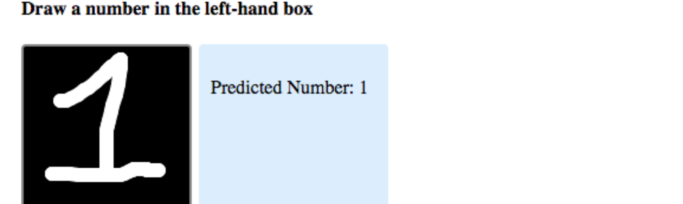
Objective
The main objective of this program is to recognize handwritten digits given to it as input and then display it.
Different users have different handwriting and so the main objective is to make the program learn to read these different handwritings.

Slide 5
Applications
Notes:
Consider talking about:
Convolutional layer
Pooling layer
ReLU layer
Fully connected layer
Loss layer

Slide 6
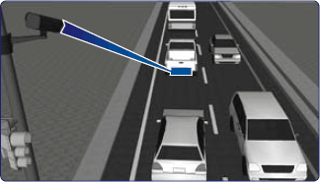
Applications
The program comes in very handy when recognizing the digits from different sources like emails, bank cheque, papers, images, etc. And also in different real-world scenarios for online handwriting recognition on computer tablets or system, recognize number plates of vehicles, processing bank cheque amounts, numeric entries in forms filled up by hand and so on.
It can also be trained to recognize digits written in different languages thus helping tourists while travelling.
Reading Number Plates using CCTV

Slide 7
Introduction To CNN
Notes:
Consider talking about:
Number of filters
Filter shape
Max pooling shape

Slide 8
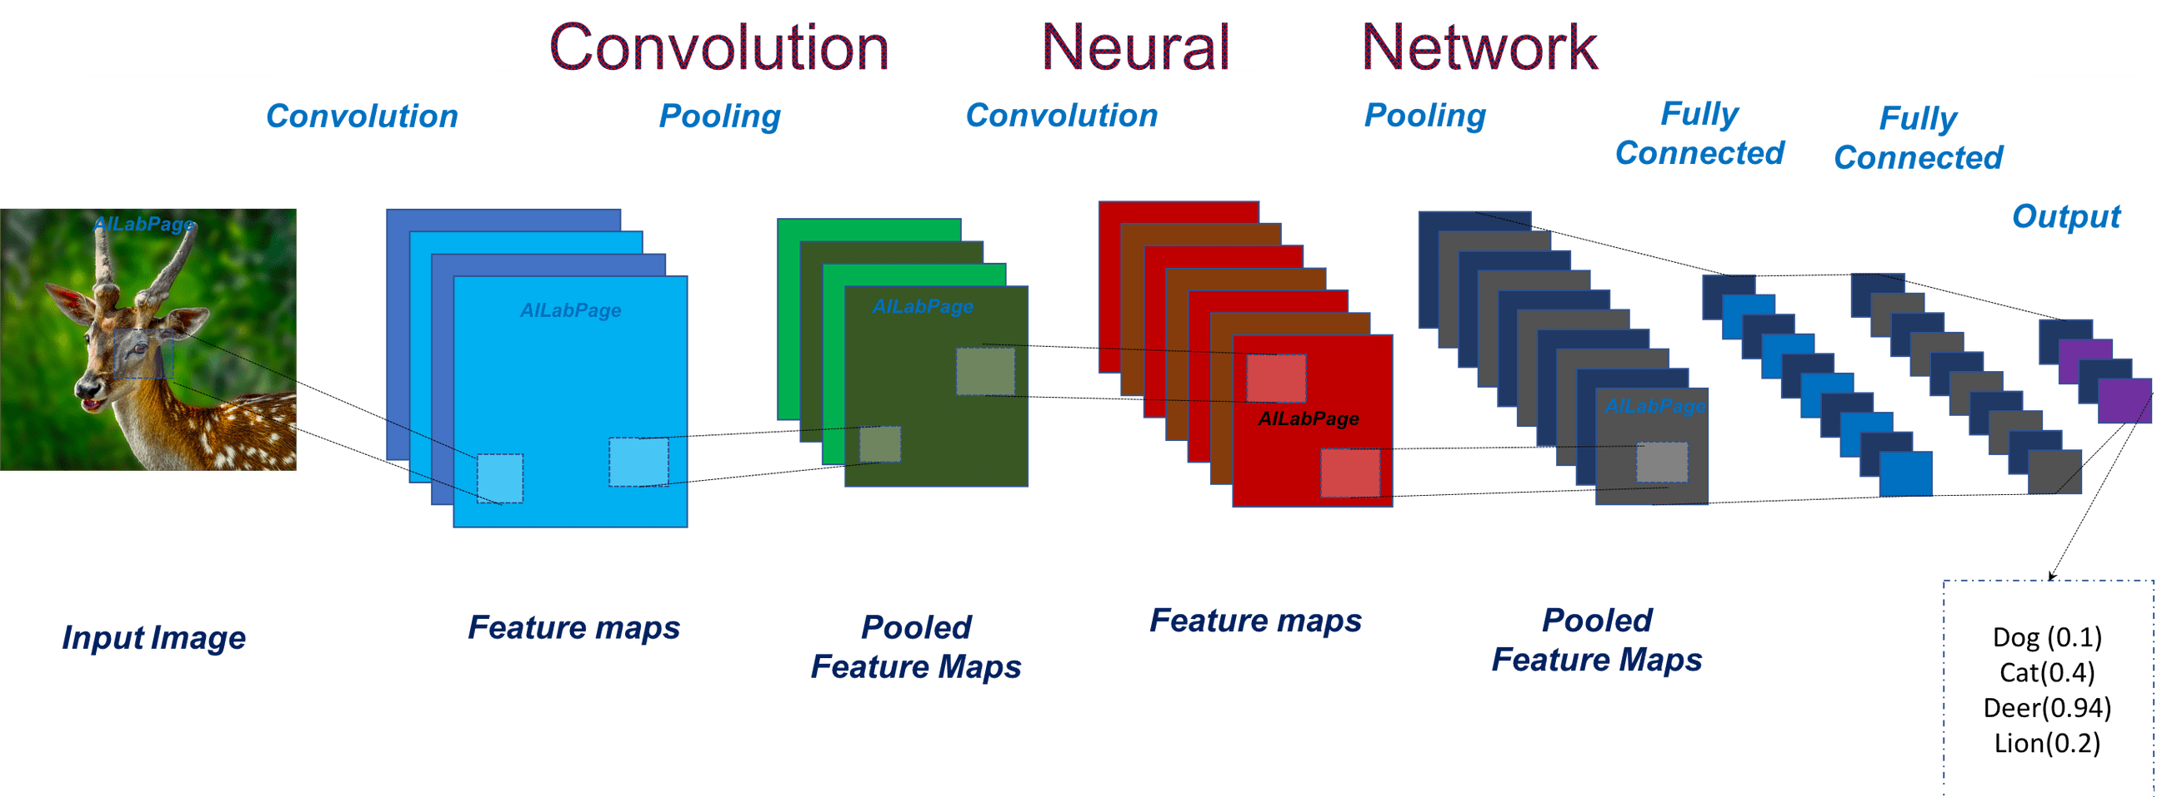
Introduction To CNN
A Convolutional Neural Network, also known as CNN or ConvNet, is a class of neural networks that specializes in processing data that has a grid-like topology, such as an image. A digital image is a binary representation of visual data. It contains a series of pixels arranged in a grid-like fashion that contains pixel values to denote how bright and what color each pixel should be.
CNNs have been successful in identifying faces, objects and traffic signs apart from powering vision in robots and self-driving cars.

Slide 9
Working
Notes:
Consider talking about:
Image recognition
Video analysis
Natural language processing
Drug discovery
Health risk assessment and biomarkers of aging discovery
Checkers game
Go

Slide 10
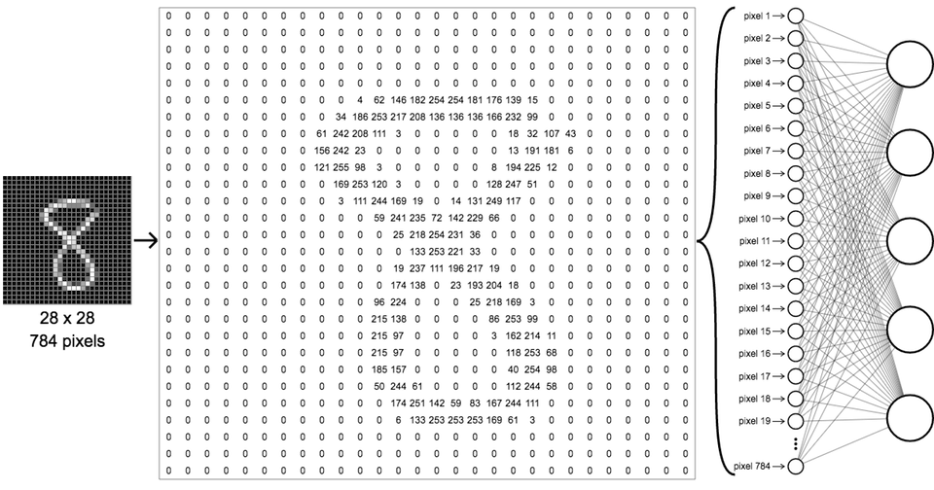
Working
When a computer or system takes an image, it just sees an array of pixel values. Suppose 480*480*3 where 480*480 is size, 3 refers to RGB values. Each of these numbers is assigned with a value of 0 to 255 as pixel intensities at that point. The key point is that based on taking the image as an input, computer system predicts and makes an assumption as output for describing the probability of the image being a said or certain class (say 0.90 for class 1, 0.96 for class 2, 0.4 for class 3).
The model trains on 60000 test images, each containing a handwritten digit and sets the weights in Neural Network and then updates them after testing them on 10000 test images.

Slide 11
Algorithm
Notes:
Consider talking about:
Deep Q-networks
Deep belief networks

Slide 12
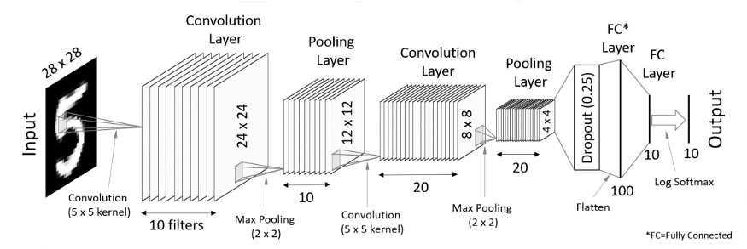
Algorithm
Preprocessing The Image: The training images are first processed to prepare them to input them in the CNN. This includes changing their size to 28*28 and gray scaling them so that there are less input parameter.
Data Augmentation: The image pixels are then rescaled between 0 and 1 and then duplicate copies of image is created by tilting the image, flipping it and also increasing and decreasing it’s size.
Passing images to the CNN: The image then passes through different feature detectors of input size which converts the image into convolutional layers. These matrices are further reduced in size by Pooling them.
Hidden Layers: The pooled matrices are then flattened into a single array and passes through the Neural Network where the model is trained and weights are assigned.
Output: Finally the fully connected layers send probability that a certain image belongs to a certain class and on this basis the output layer gives us the predicted digit.

Slide 13
My Experience
This project was my introduction to the great potential Neural Networks have, & it helped me put my theoretical knowledge in action to make a real world program.
There were a few problems that I faced during it’s making. Firstly, it took me some time to actually understand CNNs and how feature matrix works. Then while coding too I had difficulties in setting up various parameters of the CNN due to which I had to take some help from the internet.
This program has given me a lot of motivation to continue learning and to make even cooler projects in the future.

Slide 14
That’s It
Thank You!
Notes:
Consider talking about:
Convolutional layer
Pooling layer
ReLU layer
Fully connected layer
Loss layer

